Slide 1
Ceremonies
Session 210
Notes:
SAY: Welcome to session 210. In this session we will discuss the various types of ceremonies that a Troop can hold.
(click)
Matthew 18:20 For where two or three gather in my name, there am I with them.”

Slide 2
Types and Importance of Ceremonies
Opening
Closing
Induction
Court of Honor
Camp
Special patriotic or religious
Notes:
Say: “There are many types of Ceremonies. Each type of ceremony has its own purpose and feel. Each Troop will determine which and how many ceremonies they will incorporate into their annual plans. A few examples of ceremonies are:
(click) Opening
(click) Closing
(click) Induction
(click) Court of Honor
(click) Camp
(click) Special patriotic or religious
Ceremonies are important! They recognize Trailmen accomplishments along the Trail Life journey. A well planned ceremony recognizes the Trailmen’s success with the dignity and acknowledgement it deserves. A well planned ceremony will inspire all those present!”
(click)

Slide 3
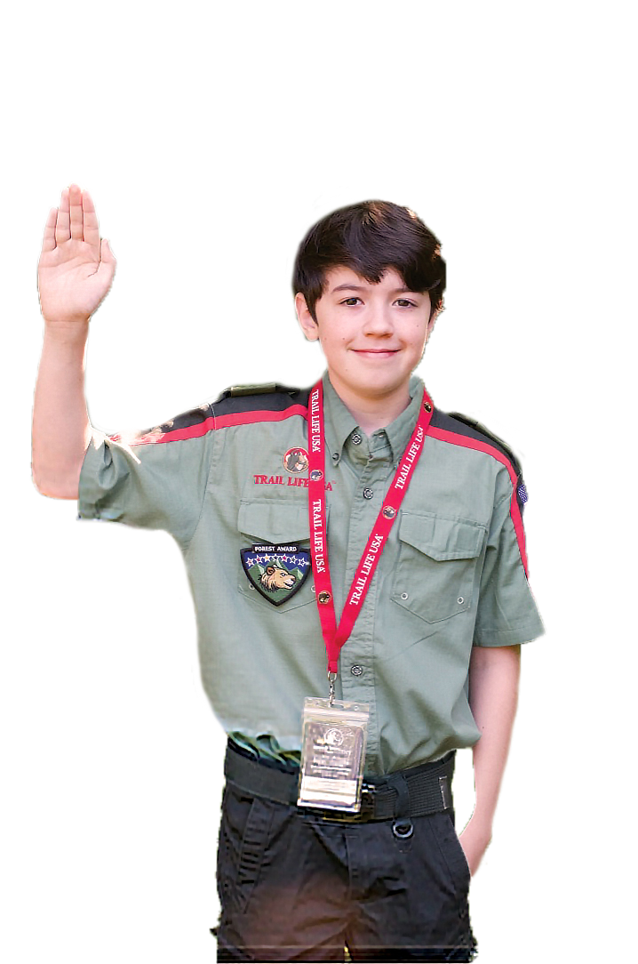
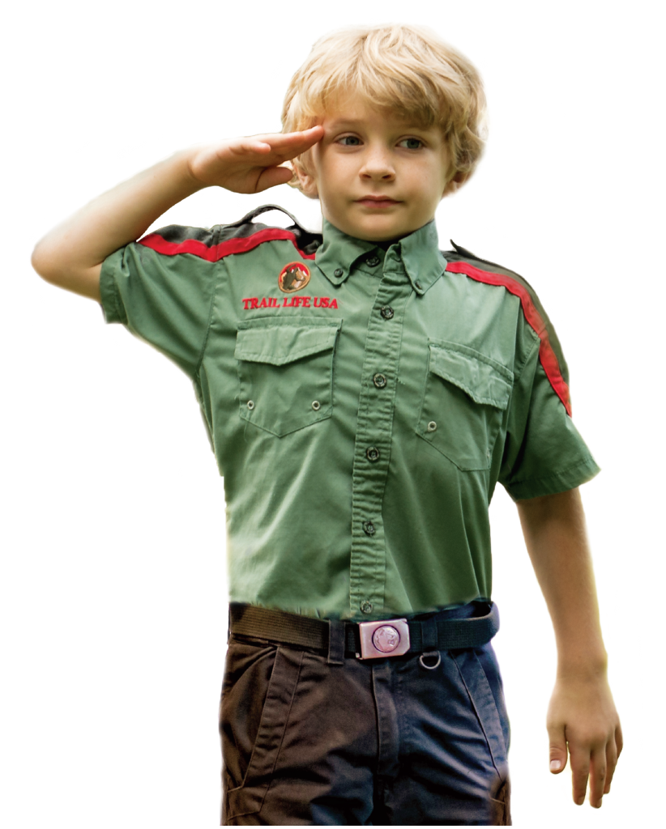
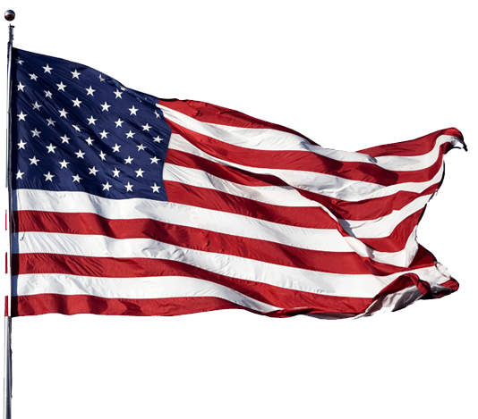

Opening and Closing Ceremonies
Notes:
Say: Opening and Closing ceremonies are part of each regular Troop meeting as well as other Troop events or other ceremonies.
The Opening ceremony will have (click) the posting of the Colors, (click) Pledge of Allegiance, (click) Trailman Oath, (click) and an invocation or opening prayer. The atmosphere for the Opening and Closing ceremonies should always be formal and reverent.
The Closing should consist of retiring the Colors and a prayer or benediction.
Each Patrol in the Troop should have an opportunity to lead the Opening and Closing ceremonies.”
(click)
(Resource: pgs. 44-46 Parent Leader Guide)

Slide 4
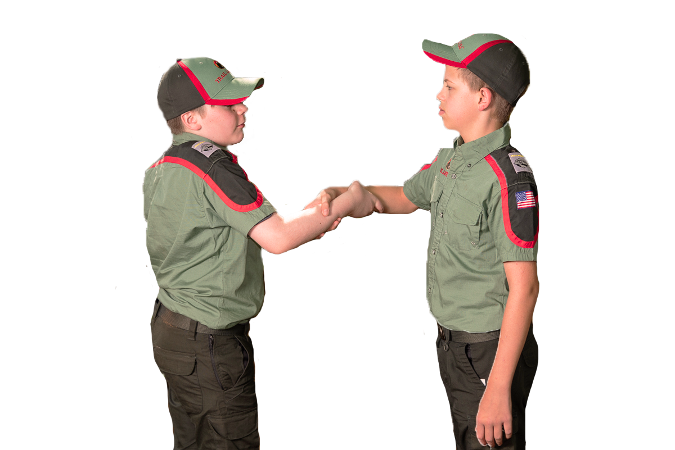
Induction Ceremonies
Notes:
Say: “Induction Ceremonies are unique ceremonies that focus on welcoming Trailmen into the Troop or a patrol. These ceremonies should be celebratory yet sensitive so as not to embarrass the Trailman. The new Trailman can be presented the Troop number patch or patrol shoulder loop and lanyard. Both adult and youth leaders should be involved in leading this ceremony. It is an option for the entire patrol to individually welcome the new Trailman. These ceremonies will be developed by the Troop Committee and Officers Conference. While these ceremonies can be short and simple, they should always be well planned.
Induction ceremonies can also be used for starting a brand new Troop or installing new youth Officers.”
(click)
(Resource: pgs. 44-46 Parent Leader Guide)

Slide 5

Court of Honor
Notes:
Say: “Courts of Honor are ceremonies to honor the Trailman for his accomplishments along the Trail. Courts of Honor could be held anytime during the Troop’s program year for presenting earned Ranks or Awards, recognizing a Trailman’s advancement, acknowledging a special award or recognition, or celebrating a Trailman earning the Freedom Award.
Because the Freedom Award is the highest Award in Trail Life USA, it should have a separate Court of Honor ceremony with a unique program. The Freedom Award ceremony should include the entire Troop family.”
(click)

Slide 6
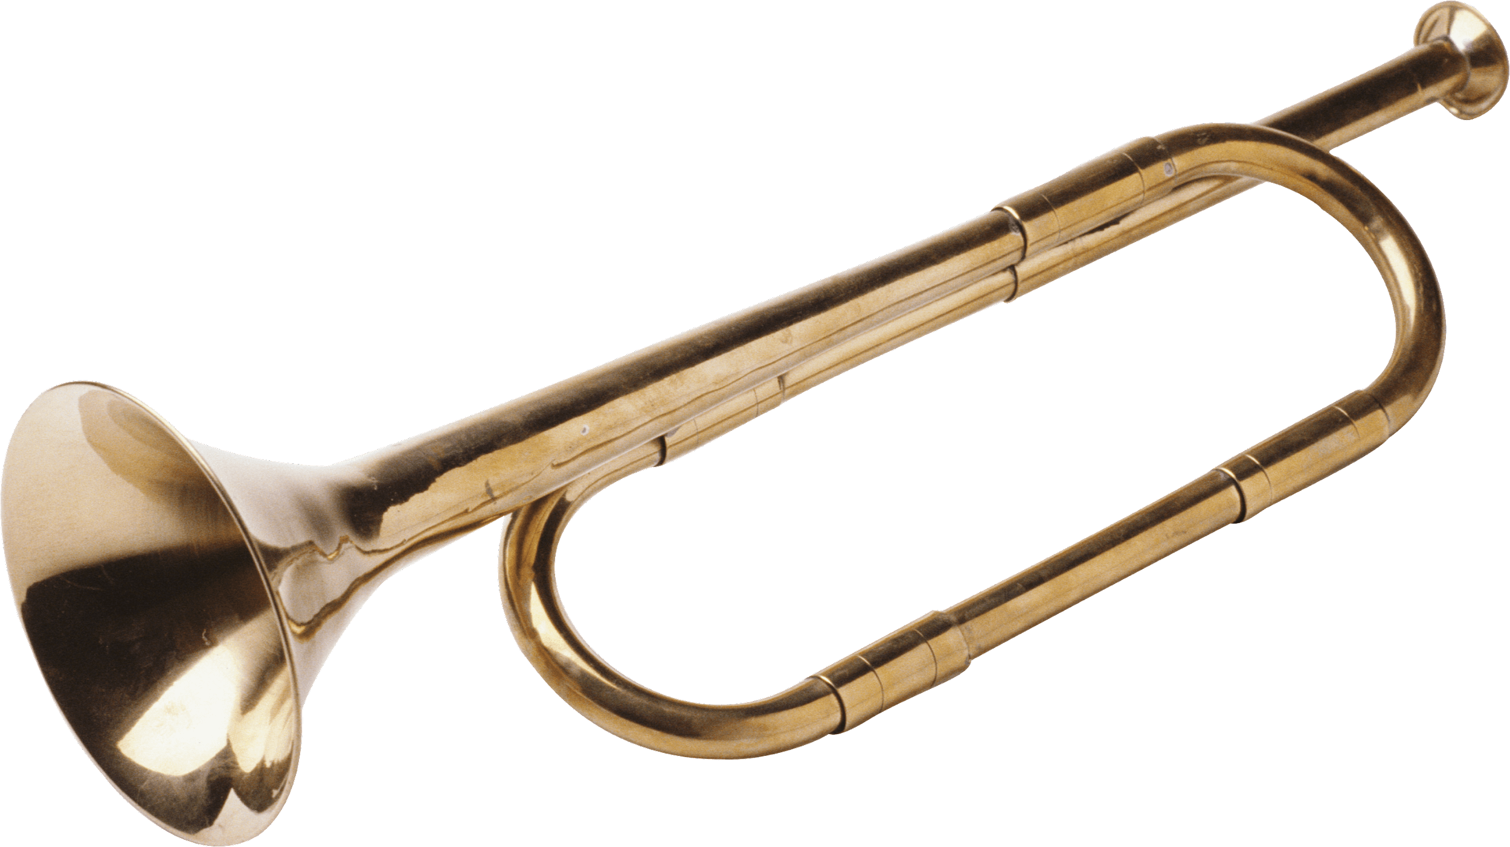
Camp Ceremonies
Notes:
Say: Camps and camping trips have unique and very memorable opportunities for ceremonies. These ceremonies are often the most remembered types of ceremonies since they are so unique. Some of the most common types of camp ceremonies include daily flag raising and lowering, flag retirement, taps at the end of a day, and various different campfire ceremonies. Each Troop and patrol will create their own camp ceremonies that will become their traditions.
Camp ceremonies provide the opportunity for Trailman to gather in friendship and fellowship. Discussions may include the adventures of the day or anticipation for activities on the following day. Memories developed at these camp ceremonies will last a lifetime.”
(click)

Slide 7


Religious or Patriotic Ceremonies
Notes:
Say: “Religious and Patriotic holidays present an opportunity for a special ceremony. The Trail Life Oath supports this by including “to serve (click) God and (click) my Country.” Religious and patriotic holiday ceremonies can be held not only in Troop meetings but also in the Charter Organization and community. Troops are encouraged to develop unique ideas for this type of ceremony. Some ideas could be to march in local parades, to hold a veterans recognition event, celebrate Easter, Christmas, or Thanksgiving, or to post flags on Flag Day or Memorial Day.
(click)

Slide 8
Questions?
Session 210
Notes:
Say: “Are there any questions about what has been shared?”
(click when you’re ready to move on)

