Slide 1
Leadership
Session 205
Notes:
Say: “In Session 205, we will explore “Leadership” not only in the day to day operation of the troop but in training up and developing servant leaders. As we read in Mark 10:45, Jesus is the greatest teacher and example of servant leadership: “For even the Son of Man did not come to be served, but to serve, and to give his life as a ransom for many.” (click)

Slide 2
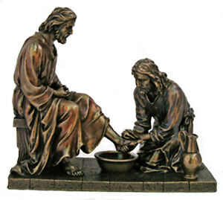
Servant Leadership
Notes:
Say: “Leading by serving is the best and most effective way to help accomplish the mission of guiding generations of courageous young men to honor God, lead with integrity, serve others, and experience outdoor adventure.
Servant leadership should be the aim and style of every Trail Life leader. The following list are some attributes of servant leadership that should be present in every Troop: a desire to serve anyone,
shared power and responsibilities, other’s needs are first,
Encouragement for people to develop and perform as highly as possible, and
A Christ-like attitude.” (click)

Slide 3
Troop Leadership Goals
Notes:
Say: Adult Troop leadership is where modelling servant leadership should shine brightest. Knowing that, each Troop leader should have the two following goals in mind while leading his Troop or program level: (click) leadership for action and (click) leadership for growth. Each of these goals have distinct skills that Trail Guides and Troop leaders should know and practice. (click)

Slide 4
Leadership for Action Skills
Determine potential
Make a plan
Meet your potential
Notes:
Say: Leadership for Action skills require a leader to: (click)
Determine Potential: Understand the strengths and weaknesses of the group. A question to ask is, “what could the group do with the right training and experience?” (click)
Make a Plan: Draw up a desirable goal that is within the group’s potential. See what skills and experiences are needed to reach it. (click)
Meet Your Potential: Through teaching and practice, prepare to achieve the goal. Pay special attention to the individual needs of members, as no two are alike. (click)

Slide 5
Leadership for Growth Skills
Use effective communication
Lead by example
Share leadership
Build trust
Notes:
Say: Leadership for Growth Skills require a leader to: (click)
Use Effective Communication: Ensure a good flow of information by using good listening and speaking skills. When people know what they should be doing and how they should be doing it, they will function better. As a leader, feedback is vital. Both constructive criticism as well as praise should be valued. (click)
Lead by Example: People are more apt to follow and copy what is modeled for them rather than what they are just told to do. A leader’s actions should demonstrate that he or she is a part of the group. (click)
Share Leadership: Delegating authority frees up the leader to focus on the overall direction, but it is also an important part of continuing the growth of the people you lead. (click)
Build Trust: The most important dynamic of a group is specialization, the ability of each member to bring to his full attention one task and do it well, relying on others to carry out the other needed chores. This system only works well where there is trust in the willingness and ability of others to do their jobs. (click)

Slide 6
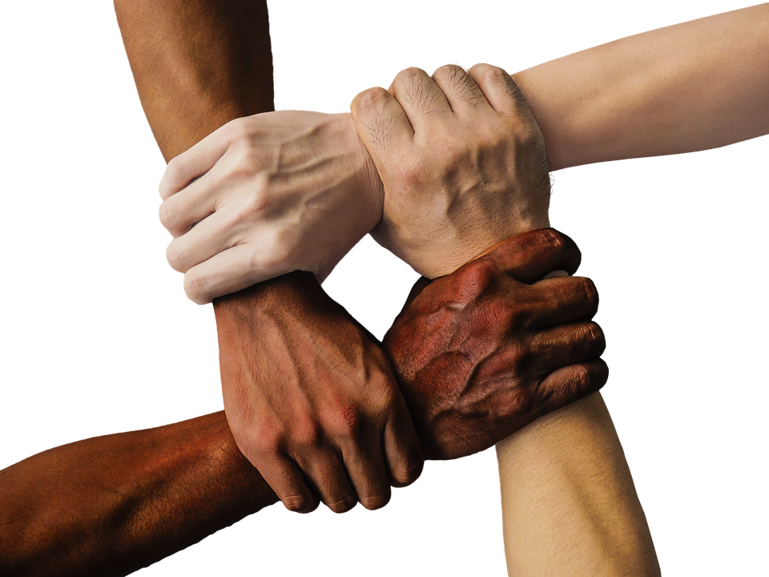
Youth Leadership Styles
Popular vote
The master
Unifying
Notes:
Say: “The teen years are a very important period for boys to learn norms of social behavior, and adults should help them do so. Adult Leaders should work to DEMONSTRATE rather than take control, they are giving the GIFT OF LEADERSHIP. As boys have more leadership ability, they need less and less from their leaders, who are increasingly there not to command but to EXPLAIN AND GUIDE.
There are THREE STYLES OF LEADERSHIP a Trailman can pursue: (click) 1. He can try to be popular by letting members vote on everything. Doing what everyone else wants to do is a sure way for him to become popular-until he runs into trouble.(click) 2. He can try to be the master by choosing what seems right to himself by barking out orders, but soon he’ll be leading a group of one. (click) 3. He can be unifying. The best leaders are unifying, harnessing the experience and enthusiasm of the team while giving clarity and direction. Leadership should be a service leaders perform for others.
All Leaders should praise publicly and correct privately.” (click)

Slide 7
Patrol Method
The Patrol Method splits a Troop into small groups that explore the theory and practice of leadership, while using the gifts of individuals to build group wellbeing.
Notes:
Say: "One of Trail Life’s core tenants is leadership. Nowhere is unifying, servant leadership better learned and practiced than by using the Patrol Method. (click) The Patrol Method splits a Troop into small groups that explore the theory and practice of leadership while using the gifts of individuals to build group wellbeing.
Here are the key points when we break this statement into parts: Under the Patrol Method, True skill comes from testing their ideas in the real world, and then committing to improve them.
Using the Patrol Method, Leadership is exercising the gift of guidance. It is undertaken in an attitude of generosity and servanthood. Using the Patrol Method, great things happen when people who have different skills work together. Using the Patrol Method, the patrol breeds wellbeing with joy, belonging, and self-worth they can only experience through a community such as a family, a church, or a well-run patrol." (click)
Resource: pgs. 305-353 The Trailman's Handbook, pg. 42-43, 118 Tools of the Trail

Slide 8
Patrol Method Benefits
Responsible Democracy
Esprit De Corps (Morale)
Interdependence
Friendly Competition
Synergy
Apprenticeship
Notes:
Say: “The major benefits of using the patrol method are the following:
(click) Responsible Democracy: Trailmen learn that the most popular candidates for leadership may not be the best leaders.
(click) Esprit de Corps or Morale: Trailmen experience things in groups that they cannot experience alone, such as friendship, encouragement, and cooperation. Because we all are made in the image of a triune God, there are certain parts of life that we must experience through companionship.
(click) Interdependence: Trailmen learn when and how to trust others and how to be worthy of their trust. Society, family, and the patrol are built upon bonds of trust that have been earned honestly and protected diligently.
(click) Friendly Competition: Trailmen desire to showcase their best work and measure it against the best work of others. When competition encourages everyone to improve and excel, everyone wins.
(click) Synergy: Trailmen learn to leverage the strengths of people working together, which collectively are better than the strengths of people working alone.
(click) Apprenticeship: Trailmen transfer their winning skills and attitudes from Patrol Leader to Patrol Member.” (click)
Resource: pgs. 305-353 The Trailman's Handbook; pg. 42-43, 118 Tools of the Trail

Slide 9
Patrol Method Application
Involve everyone (Team Concept)
Allow them to make activity decisions
Encourage accountability
Motivate one another
Notes:
Say: “How is the Patrol Method applied?
(click) Involve everyone. Building a Team requires everyone to participate.
(click) Trailmen need to be allowed to make decisions about the activities of the troop and their patrol speaking as a patrol.
(click) In these small groups, accountability is crucial and most easily developed as Trailmen strive to work together.
(click) Patrols that function well will help motivate one another in all parts of Trail Life.” (click)
Resource: pgs. 305-353 The Trailman's Handbook

Slide 10
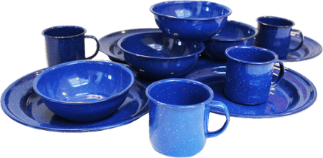
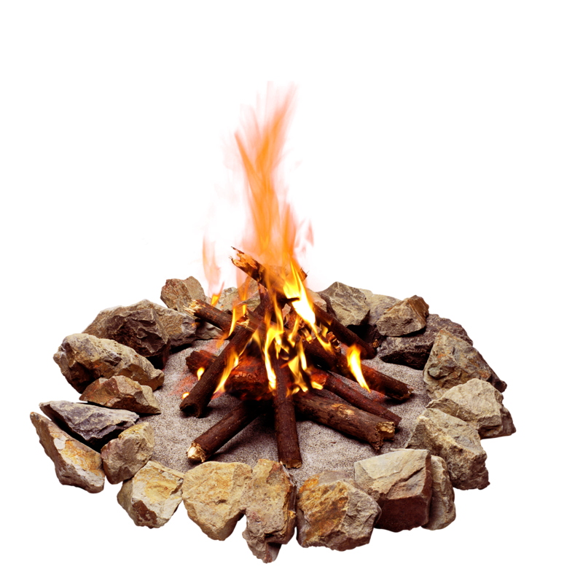
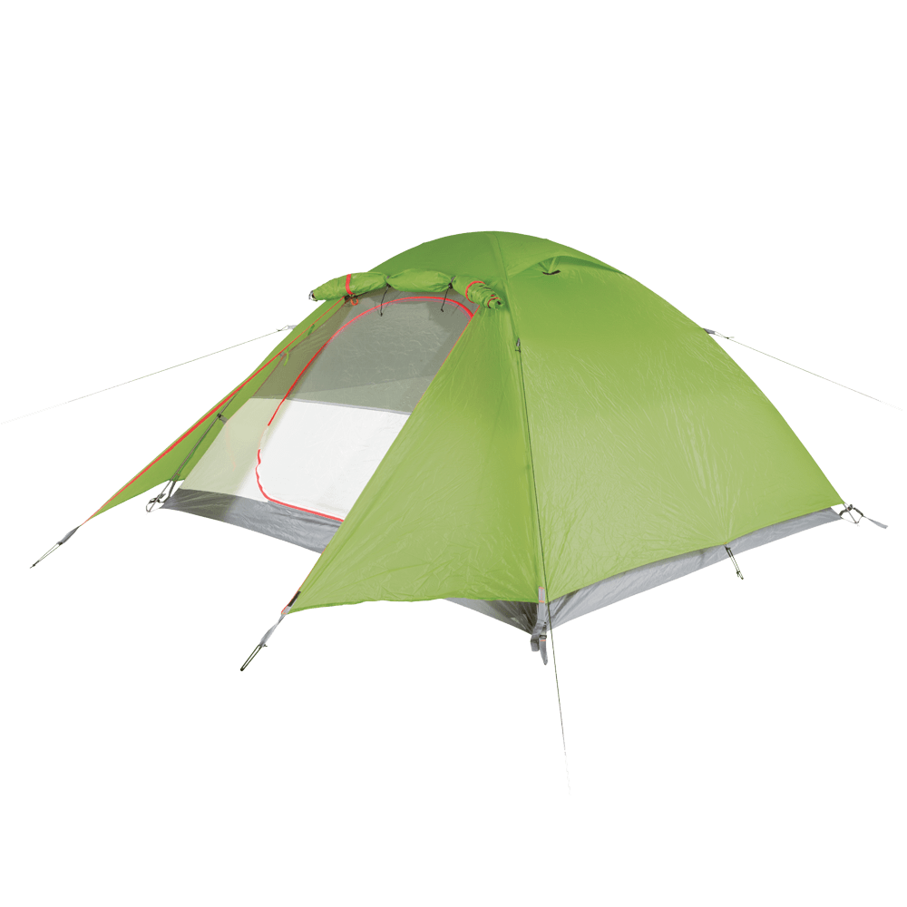
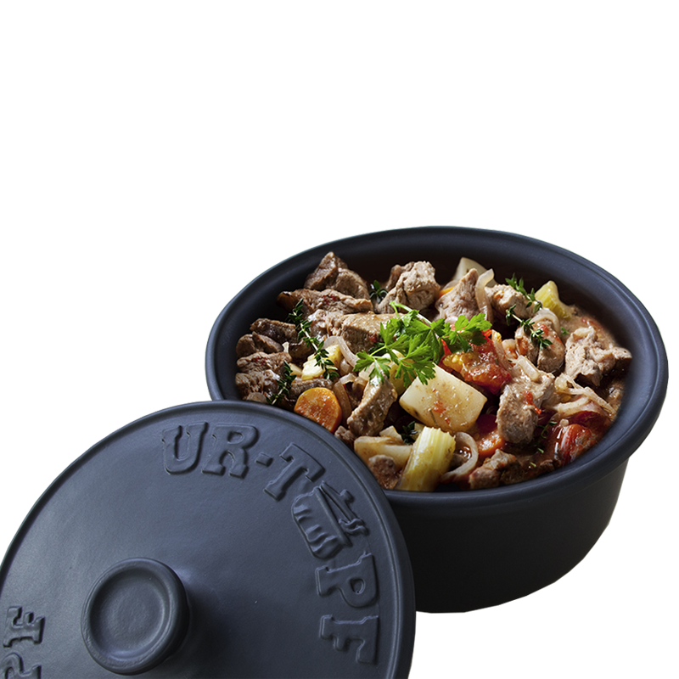
Patrol Duty Roster
Notes:
Say: “Patrol Members do not have to do everything on a schedule, but certain things should be put on a duty roster and done in a structured manner within the patrol.
(click) COOKING: Each boy should gain skills and confidence preparing a variety of menus and food. Success should be measured. This is an important skill for learning self-reliance and project management.
(click) CLEANUP: Washing cooking and serving utensils properly is a health and safety issue. It is a responsibility that needs to be completed for the welfare of the patrol and troop.
(click) FIRE TENDING: Starting, feeding, and putting out a fire are big responsibilities. They should be taken seriously.
(click) ERRANDS: By doing other and sometimes smaller tasks needed for the patrol, a Trailman shows what type of leader he will become.
(click) LAYOUT: Setting up camp with structure helps to build leadership in Trailman. A proper layout for the patrol campsite shows proven leadership.” (click)
Resource: pgs. 305-353 The Trailman's Handbook

Slide 11
Patrol Spirit
Notes:
Say: The way to create patrol spirit is through emulation and competition. The patrol method will not succeed without patrol spirit. The use of a patrol flag is a representation of who they are, what their name is. The patrol call shouted out celebrates a job well done. Patrols bond when they work together and build strong ties with one another. Healthy competition against other patrols will help practice skills they have learned and it will encourage unity.” (click)
Resource: pgs. 305-353 The Trailman's Handbook

Slide 12
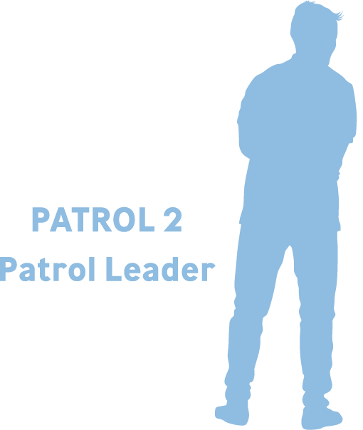
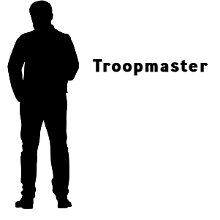
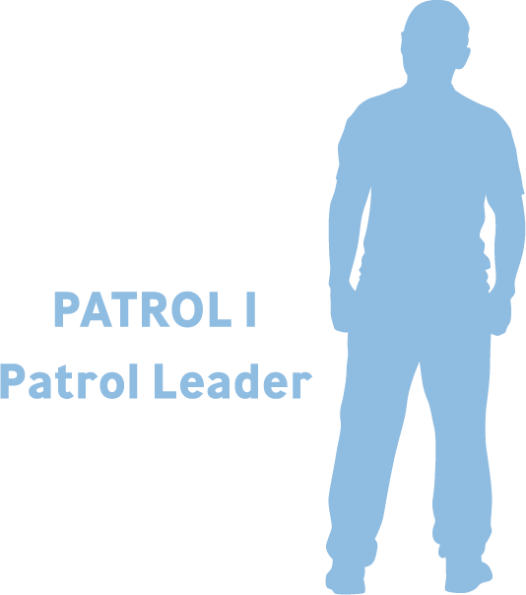
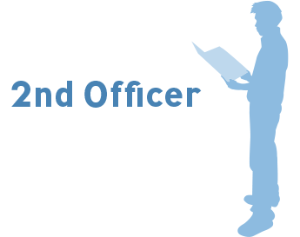
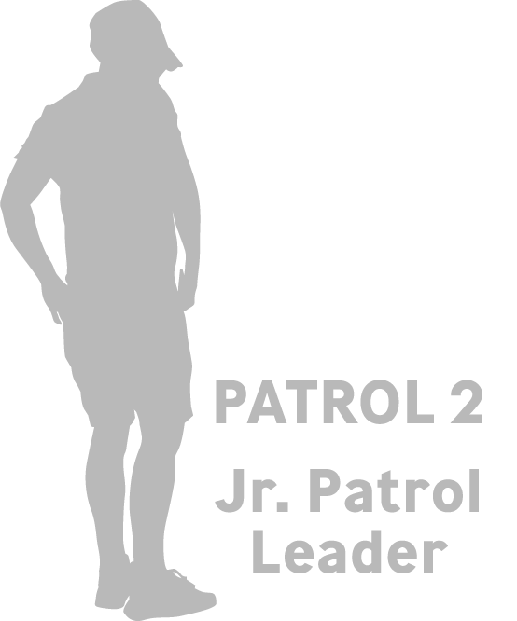
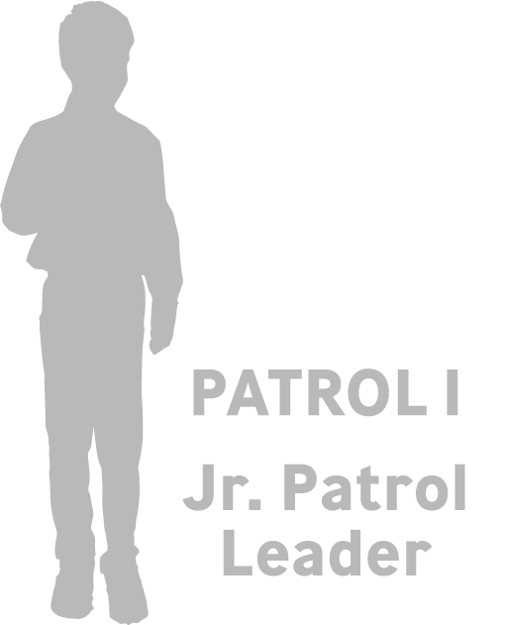
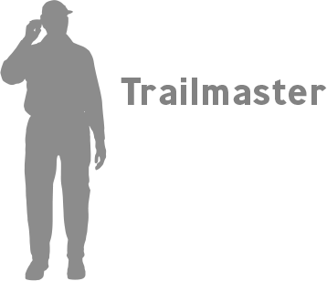
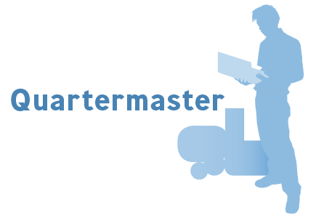
The Officer’s Conference
Notes:
Say: “At the Navigators and Adventurers levels, leadership is taken to another level with the Officer’s Conference. (click) Patrol Leaders, Jr. Patrol Leaders, the elected youth Officers, other Troop appointed youth leaders together with the Troopmaster, Advisor, Trailmaster and Trail Guides meet regularly, separate from normal patrol meetings to plan and set agendas for all of the patrols. The Officer's Conference alongside the Troop Committee leads the development of an exciting Annual Program plan that encourages fun, fellowship, and personal growth within the framework of the Trail Life program.” (click)
Resource: pgs. 305-353 The Trailman's Handbook

Slide 13
Patrol Method for Woodlands Trail
Notes:
Say: “The Woodlands Trail has patrols led entirely by adults (click) who model fair, wise, and patient leadership. While this age level does not use the full Patrol Method, members learn the first great leadership skill: the most important person you lead is yourself. Each Fox, Hawk and Mountain Lion Trailman is expected to grow toward leading himself well, whether anyone else is watching or not.” (click)
The Trailman's Handbook pg 273

Slide 14
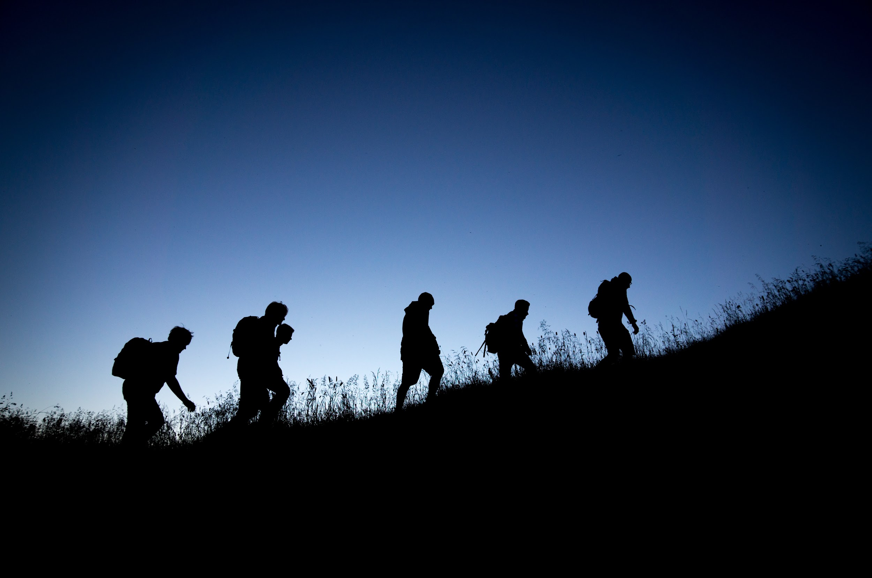
The Path of Leadership
You then, my child, be strengthened by the grace that is in Christ Jesus, and what you have heard from me in the presence of many witnesses entrust to faithful men, who will be able to teach others also. 2 Tim 2:1-2 ESV
Notes:
Say: ”As the center of a Trailman's life moves outward, his desire to control the environment shifts with it. This is how leadership works in the boy becoming a man, gradually shifting from a way to receive to a way to give. Training Youth Leaders is an investment in their lives as a step to becoming a godly man. We believe it is critical for all leaders, at all levels to develop skills for passing on servant leadership abilities and experiences to the next generation. (click)
“You then, my child, be strengthened by the grace that is in Christ Jesus, and what you have heard from me in the presence of many witnesses entrust to faithful men, who will be able to teach others also.” (click)

Slide 15
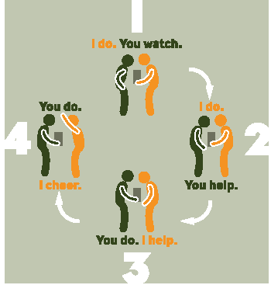
The Discipleship Square
Notes:
Say: “Every skill learned goes through three stages: when you can't get it right, when you can get it right, and when you can't get it wrong. The Discipleship Square is a teaching tool to help Trail Guides with teaching, demonstration, mentorship, and application. This tool is modeled after Jesus’ example of how he taught his disciples and still teaches each of us.
Step one is I Do, You Watch: Tell the Trailman why the skill is important. Communicate this clearly.
Step two is I Do, You Help: Demonstrate the skill slowly and explain each step along the way. After the first exhibition do another one a little more quickly still ensuring to show all the steps clearly.
Step three is You Do, I Help: Allow the Trailmen to show what was just taught and help them when they get stuck in a step. Encourage with patience.
Step four is You Do, I Cheer: Trail Guides want every Trailman to succeed. As they repeat what was taught, encourage practice so that they can't get it wrong.” (click)
Resource: pg. 332-334 The Trailman’s Handbook

Slide 16
Questions?
Session 205
Notes:
Say: “Are there questions about what has been shared?”
(click when you’re ready to move on)

