Slide 1
Navigators/ Adventurers
Program Overview
Session 107
Notes:
Say: “In Session 107, we will show you an overview of the structure and advancement of the Trail Life Navigators and Adventurers Programs.” [Click]

Slide 2



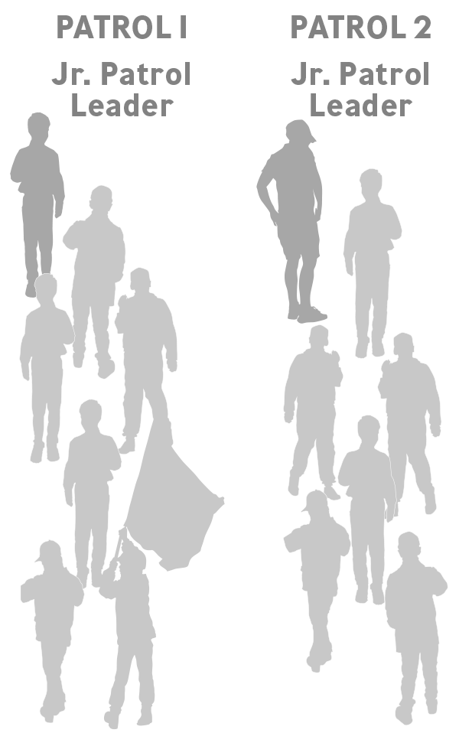
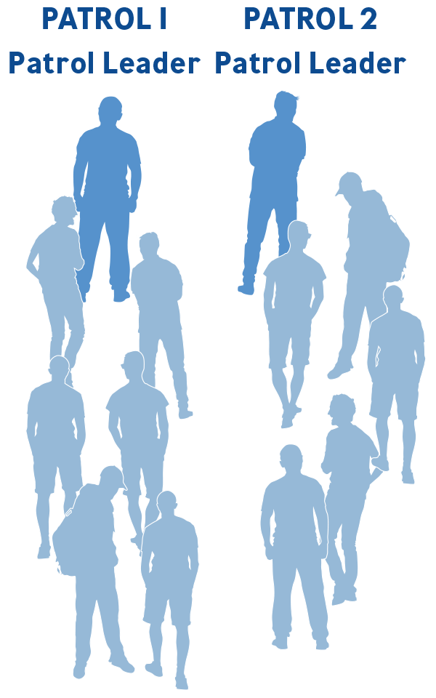

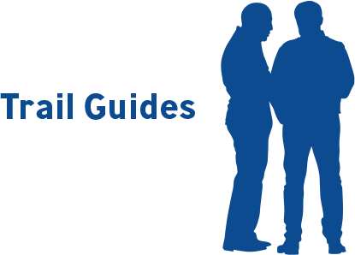
Patrol Method Structure
Notes:
Say: “The Navigators and Adventurers Programs are made up of patrols of six to eight Trailmen each. The “Patrol Method” is how Trailman participate within these two program levels. (pause)
[Click] Patrols function as a small family inside the big family of your program level and Troop. Each Patrol elects their own Patrol leadership from among themselves, or, if necessary, adult leadership may assign those roles. These Patrol Leaders and Junior Patrol Leaders are members of the Officers’ Conference, which provides direction and leadership for both the Navigators and Adventurers Patrols. (pause)
Each Patrol camps, hikes, and learns together. Trailmen grow strong and wise when they are committed to working and staying together, even through difficult circumstances. (pause)
[Click] Each Patrol is assisted by Registered Adult Trail Guides who follow the Two Deep Leadership principle. (pause)
[Click] Boys holding elected offices include the First Officer, who is an Adventurer and serves as the “voice of the Troop” as well as provides structure and leadership to the Officers’ Conference (pause)
[Click] the Second Officer, who assists or stands in for the First Officer, (pause)
[Click] and the Quartermaster, who is responsible for every Patrol’s gear. (pause) [Click]
(Resource: pgs. 315-319 The Trailman’s Handbook Third Edition; pgs. 119-126 Tools of the Trail)

Slide 3
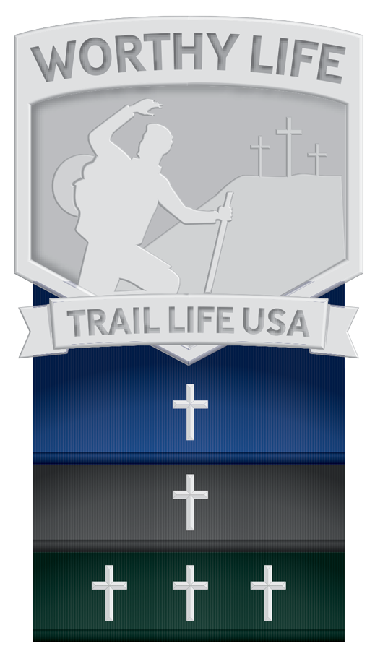
Worthy Life Award
Distinct requirements for the Navigators and Adventurers Programs
Devotional Activity
Discipleship Activities
Disciplines Activities
Demonstration Activities
Notes:
Say: “Again, the Trail Life USA Worthy Award is the Faith-Building Award for all Trailmen at all ages. (pause)
There are [Click] distinct requirements for Navigators and Adventurers according to their age. (pause)
The Four activities they will focus on are:
[Click] Devotional Activity,
[Click] Discipleship Activities,
[Click] Disciplines Activities,
[Click] and Demonstration Activities. (pause)
As the Trailman earns the Worthy Life Award for his program level, he is awarded a silver cross to affix to the appropriate award ribbon: Navigators use the gray ribbon and Adventurers use the blue ribbon.” [Click]
(Resource: pgs. 89-92 Tools of the Trail; pgs. 93-97 The Trailman’s Handbook Third Edition)

Slide 4
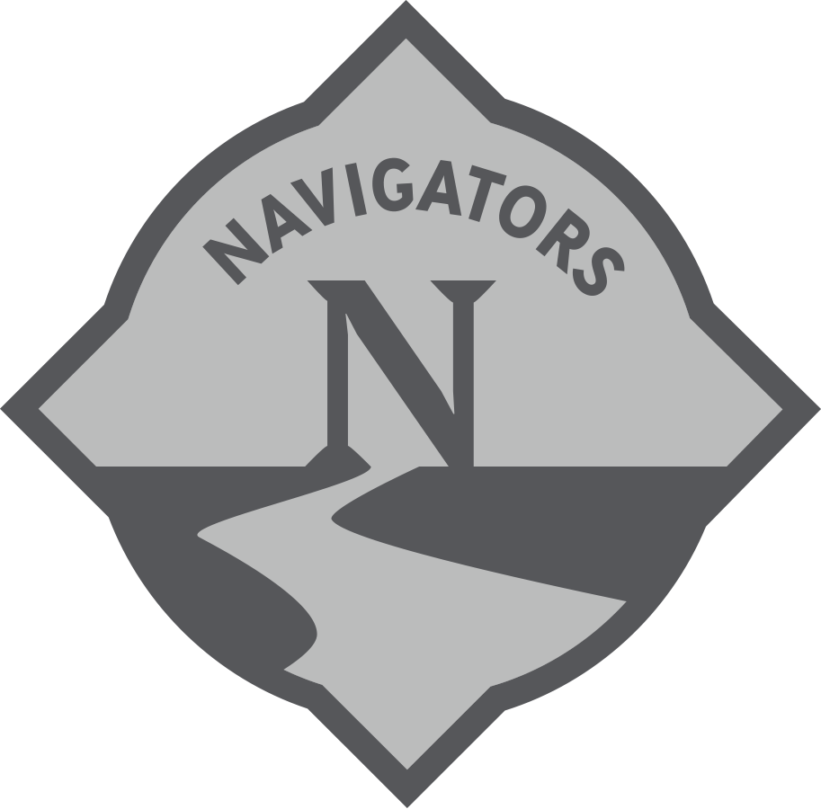
Navigators Program Overview
3 year program
Trailmen split into peer group patrols
Led by a Jr. Patrol Leader along with Adult Trail Guides
Notes:
Say: “The Navigators program is an inspirational and richly rewarding
[Click] 3 year program for 11 to 13 year old boys to help them achieve mental, moral, emotional, and physical fitness exploring God’s great outdoors.(pause)
[Click] Trailmen are split into peer group patrols to learn and execute the program in small groups. (pause)
[Click] Trailmen begin to exercise the leadership skills they will need throughout their lives by serving in leadership roles within their patrols along with guidance from adult leaders called Trail Guides.” [Click]
(Resource: pg. 10 Woodlands Trail Handbook Second Edition; pg xix The Trailman’s Handbook Third Edition; pg. 29 Parent Leader Guide)

Slide 5

Adventurers Program Overview
4 year program
Trailmen split into peer group patrols, led by a Patrol Leader
Youth 1st Officer, 2nd Officer, and Quartermaster
Notes:
Say: “The Adventurers program is a [Click] four year program designed to foster wisdom. It is a high-adventure, high-energy program for 14-17 year-old Trailmen. (pause)
[Click] Each patrol is led by a Patrol Leader selected by their peers. Adult Trail Guides are present to offer assistance and mentorship, but play a vastly diminishing leadership role as the boys mature and grow in their own leadership skills. (pause)
[Click] Adventurers are also the youth leadership of the Troop. They lead the Troop as high-profile leaders in the roles of First Officer, Second Officer, and Quartermaster.” [Click]
(Resource: pg. 10 Woodlands Trails Handbook; Second Edition; pg xix The Trailman’s Handbook Third Edition; pg. 29 Parent Leader Guide)

Slide 6



Rank Advancement
Core Skills Trail Badge Completion
Servant Service
Troop Involvement
Leadership (Ready Trailman Rank only)
Notes:
Say: “Trailmen in the Navigators and Adventurers programs begin achieving “Ranks”. The first three ranks earned by Trailmen who join the Troop at the Navigators or Adventurers level are: [Click] Recruit Trailman, [Click] Able Trailman, and [Click] Ready Trailman. (pause)
These ranks are achievement based and cumulative. Each of these ranks focus on [Click] Core Skills Trail Badge completion, (pause)
[Click] servant service within their community, (pause)
[Click] and making sure they maintain Troop involvement in meetings, campouts and activities.
[Click] The Ready Trailman Rank adds a Leadership requirement.” [Click]
(Resource: pg.xiii-xv The Trailman’s Handbook Third Edition)“
(Resource: pg. 52-62 The Trailman’s Handbook Third Edition)

Slide 7

Navigators Capstone Award
Troop Involvement
Navigator Worthy Life Award
Community/Area Service Project
Notes:
Say: “If a Trailman earns the Ready Trailman rank while he is a Navigator, he will have the opportunity to earn the capstone award for the Navigators Program called [Click] the Ridgeline Award. The Ridgeline Award requirements include [Click] Troop involvement, [Click] the Navigator Worthy Life Award, [Click] and a Community or Area service project.
(Resource: pg.64-66 The Trailman’s Handbook Third Edition; pg. 81 Parent Leader Guide; pg. 95-96 Tools of the Trail)

Slide 8



Adventurers Rank Advancement
True Freedom Trail Badges
Servant Service, Troop Involvement & Leadership, and Freedom Trail Progress
Notes:
Say: “The highest three ranks in Trail Life are reserved for Adventurers only and are referred to as “True Freedom” Ranks. The first True Freedom Rank is [Click] the Journey Rank followed by [Click] the Ascent Rank leading to the highest True Freedom Rank, [Click] the Horizon Rank. (pause) These ranks are achievement based and cumulative along with the Core Skills Ranks. Navigators may not earn these True Freedom Ranks until they become Adventurers within their Troop.
[Click] “The Trail Badges required for the True Freedom Ranks are called True Freedom Trail Badges. While Adventurer Trailmen may work on, and complete, Core Skills Trail Badges, Navigators may not work on True Freedom Trail Badges until becoming an Adventurer.
Other requirements include [Click] more servant service within the community, Troop involvement and Leadership, and certain Freedom Trail progress. (pause)
[Click]
(Resource: pg.68-82 The Trailman’s Handbook Third Edition)

Slide 9
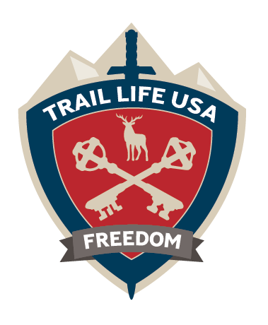
Freedom Award
Pinnacle Award for Trail Life
Freedom Experiences
Servant Leadership Project
Troop Involvement
Adventurer Worthy Life Award
Notes:
Say: [Click] “The Freedom Award is the pinnacle award of Trail Life USA. The path to Freedom is one that will stretch the Trailman as a young man and hone necessary skills while growing in leadership and service. (pause)
The Adventurer who earns the Freedom award is known as a Freedom Rangeman and, as such, they will be mature enough to understand the freedom that is found in Christ. (pause)
[Click] It requires completion of defined Freedom Experiences throughout his time as an Adventurer in multiple areas which include community service, civic education, outdoor skills, or faith related activities.
These are intended to engage the Trailman in active citizenry in his community involving those inside and outside of Trail Life. (pause)
[Click] The Adventurer also completes a Servant Leadership Project to put his servant leadership to work in accomplishing a large scale project benefitting his community. (pause)
[Click] He is required to continue active Troop involvement to mentor and encourage other Trailmen while he is completing his award requirements. (pause)
[Click] Finally, the Adventurer Worthy Life Award must be completed as he continues to build his understanding and faith in Christ.” [Click]
(Resource: pg.83-89 The Trailman’s Handbook Third Edition; pg.81 Parent Leader Guide; pg 97-99 Tools of the Trail)

Slide 10







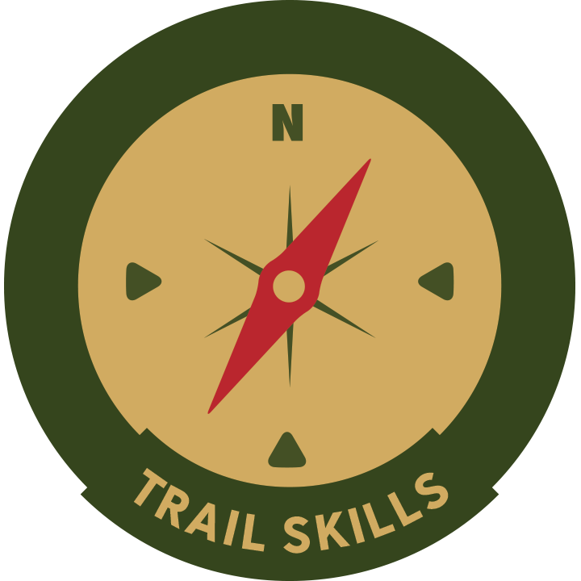

Core Skills Trail Badges
Notes:
Say: “Nine Core Skills Trail Badges are completed as a Trailman earns his first three ranks.
These Trail Badges represent the requisite skills of Trailmen during their time in Trail Life. (pause)
They are:
[Click] Aquatics,
[Click] Camping,
[Click] Fire Ranger,
[Click] First Aid,
[Click] Our Flag,
[Click] Outdoor Cooking,
[Click] Ropework,
[Click] Trail Skills, and
[Click] Woods Tools.” [Click]
(Resource: pg. 138-233 The Trailman’s Handbook Third Edition)

Slide 11









True Freedom Trail Badges
Notes:
Say: “The highest three ranks in Trail Life require the Trailmen to earn six True Freedom Trail Badges targeted at the needs of older boys as they rapidly approach manhood.(pause)
They are:
[Click] Citizenship,
[Click] Emergency Preparedness,
[Click] Family Man,
[Click] Outdoor Life,
[Click] Personal Resources, and their choice of a fitness Trail Badge, selected from the following:
[Click] Cycling, [Click] Fitness, [Click] Swimming, or [Click] Hiking.” [Click]
(Resource: pg.138-233 The Trailman’s Handbook Third Edition)

Slide 12



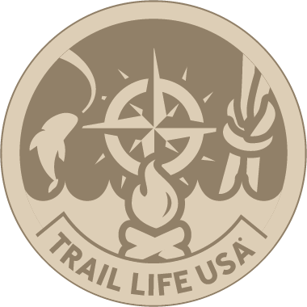

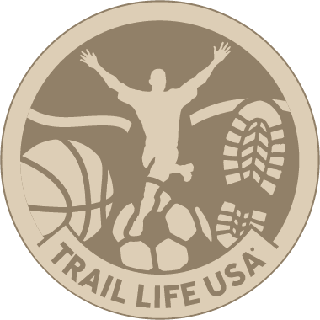

Frontiers
Heritage
Hobbies
Life Skills
Outdoor Skills
Science & Technology
Sports & Fitness
Values
Notes:
Say: “The same areas of study that the Woodlands Trail Patrols use are called Frontiers at the Navigators and Adventurers level. (pause)
They are [Click] Heritage. [Click] Hobbies, [Click] Life Skills, [Click] Outdoor Skills, [Click] Science & Technology, [Click] Sports & Fitness, and [Click] Values. (pause)
The seven Frontiers provide both structure for advancement and personal growth objectives that will make a better man - more like Jesus, who is our example.” [Click]
(Resource: pg. 133-136 The Trailman’s Handbook Third Edition)

Slide 13
Elective Trail Badges
Topics with Personal Appeal
Pre-written
Design Your Own Badge
One, Any, or All Frontiers
Notes:
Say: “Trail Badges give Trailman a foundation of knowledge and skills to help them navigate the frontiers of life. Elective Trail Badges strengthen their knowledge and skills, and help him round out his experience and deepen his expertise with [Click] topics that have personal appeal. (pause)
Trail Life USA has [Click] published Elective Trail Badges available online that a Trailman can select from or he has the option to [Click] design his own Elective Trail Badge in an area that interests him within the Design your own Badge guidelines. (pause)
“A Trailman may select his Elective Trail Badges from [Click] one, several, or all of the Frontiers. There are not specific breakdowns of Frontiers required, only a required number of Elective Trail Badges.”
“Upon completing an Elective Trail Badge, the Trailman will earn a wooden medallion that can be affixed to the Trailman’s Standard corresponding to the appropriate Frontier for that Badge” [Click]
(Resource: Trail Life Connect, pg.368-369 The Trailman’s Handbook Third Edition)

Slide 14
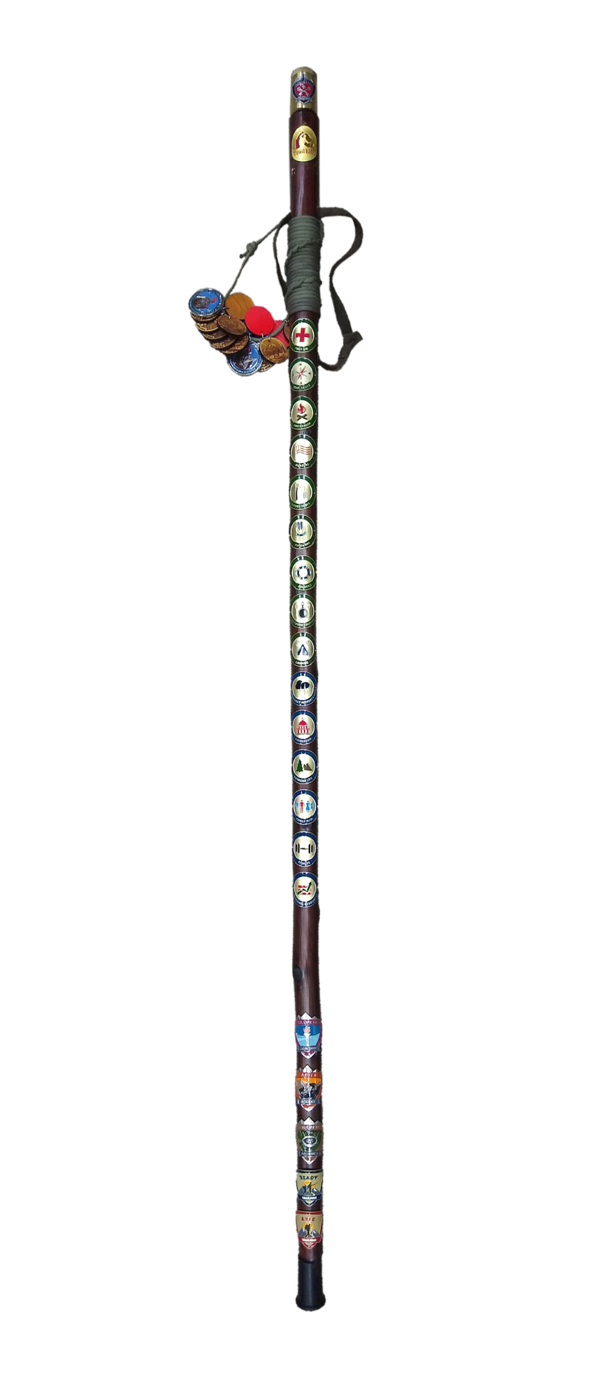
The Standard
Notes:
Say: “The Trailman’s Standard is the official uniform staff used by a Navigator or Adventurer Trailman to display his achievements. (pause)
On it, he may affix his earned Ranks and Awards, Trail Badges, Service Stars, Elective Trail Badge medallions and, if he reaches the peak of the Trail, his Freedom Award topper. (pause)
It comes to the Trailman unadorned, awaiting the unique achievements he can fasten to it as he learns, grows, and makes lifelong memories with Trail Life USA.” [Click]
(Resource: pg.36-37 The Trailman’s Handbook Third Edition; pg. 102-103 Tools of the Trail)

Slide 15
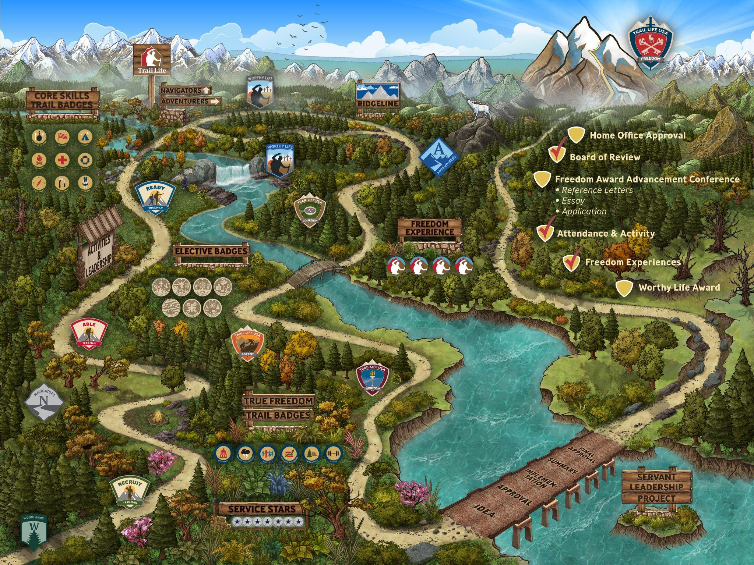
Tracking Resources
Notes:
Say: [Click] “The official advancement tracking for all Trailmen is Trail Life Connect. Specifically for Navigators and Adventurers, the Freedom Trail is the best place to view and track each Trailman’s advancement. Navigators and Adventurers will need to take ownership of their own advancement tracking and will need to log into Trail Life Connect and familiarize themselves with the Freedom Trail under their Profile.” [Click]
(Resource: Trail Life Connect)

Slide 16
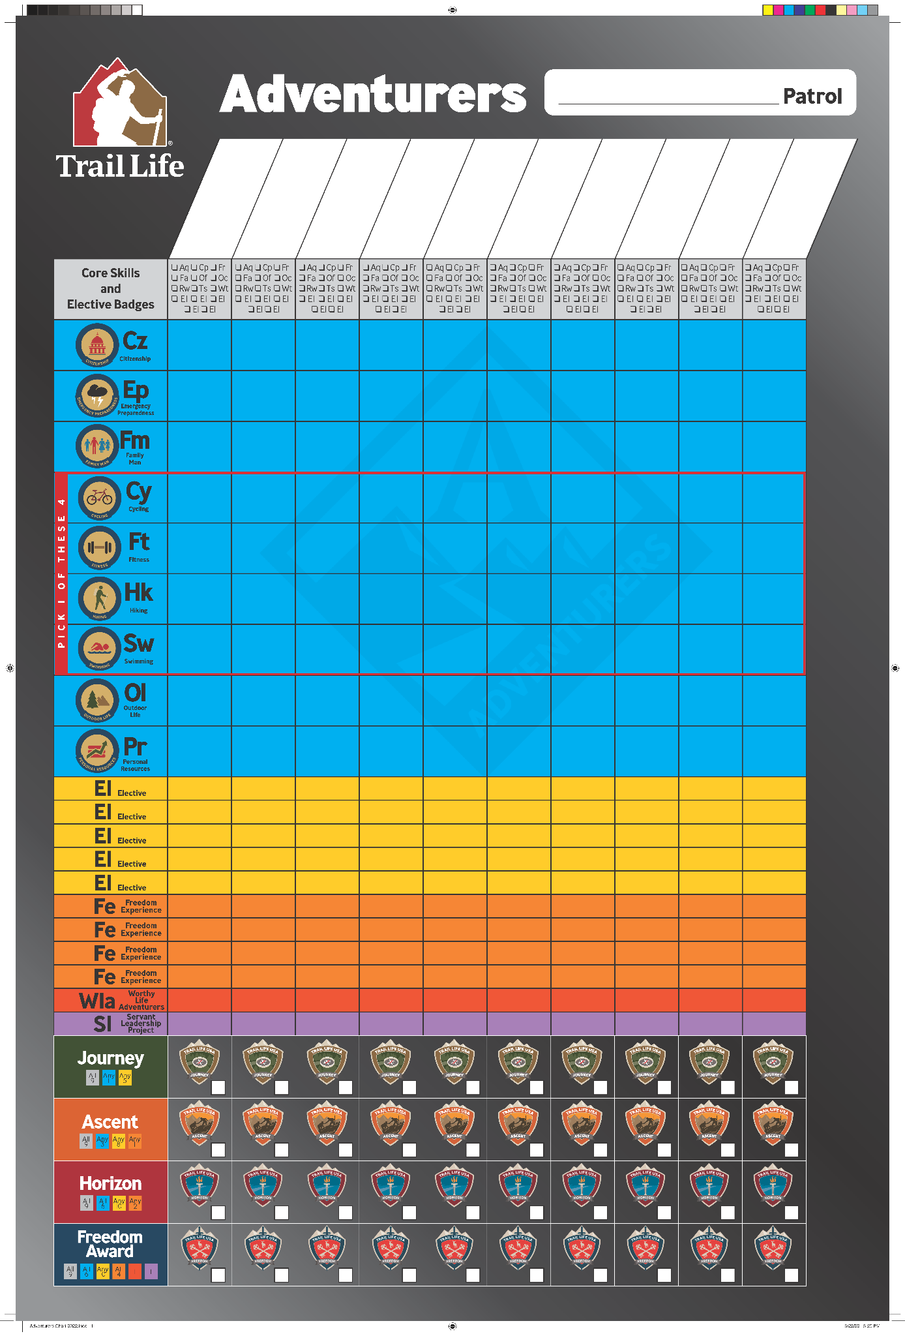
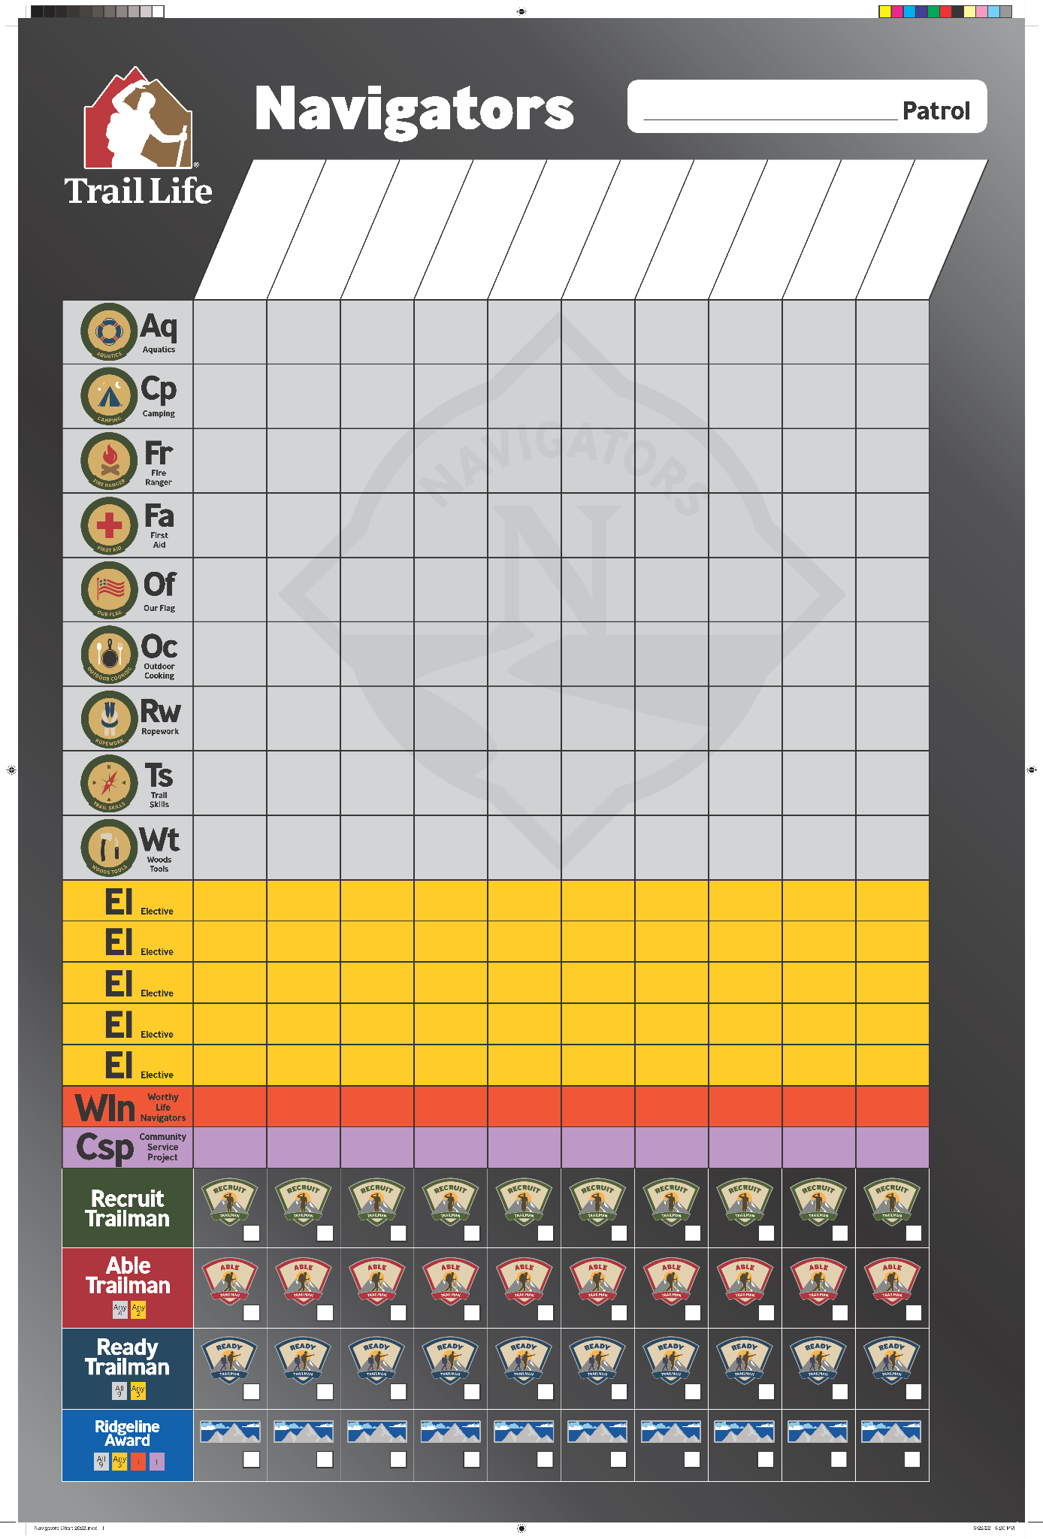
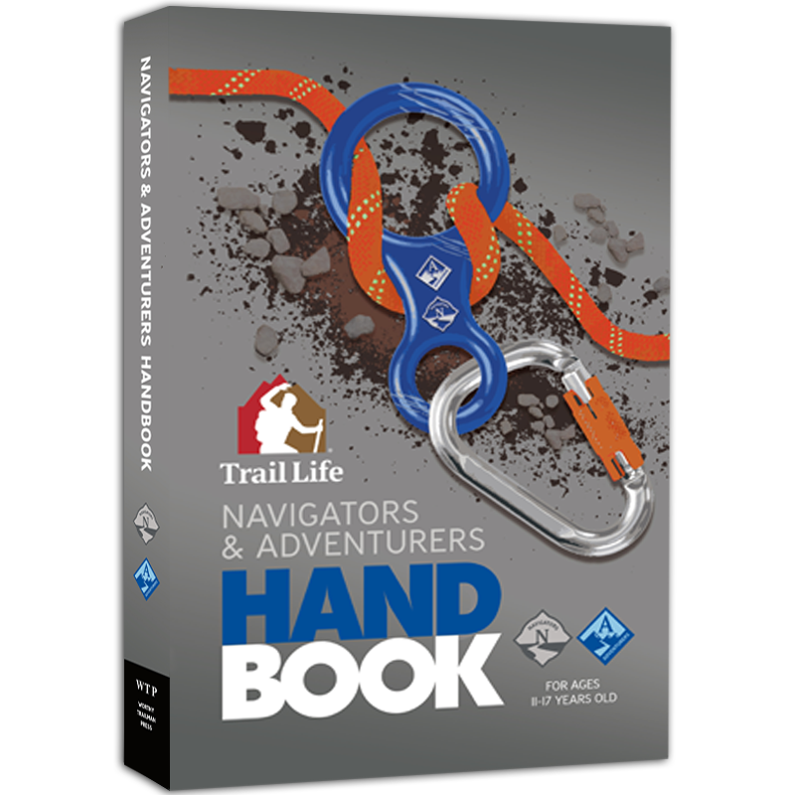
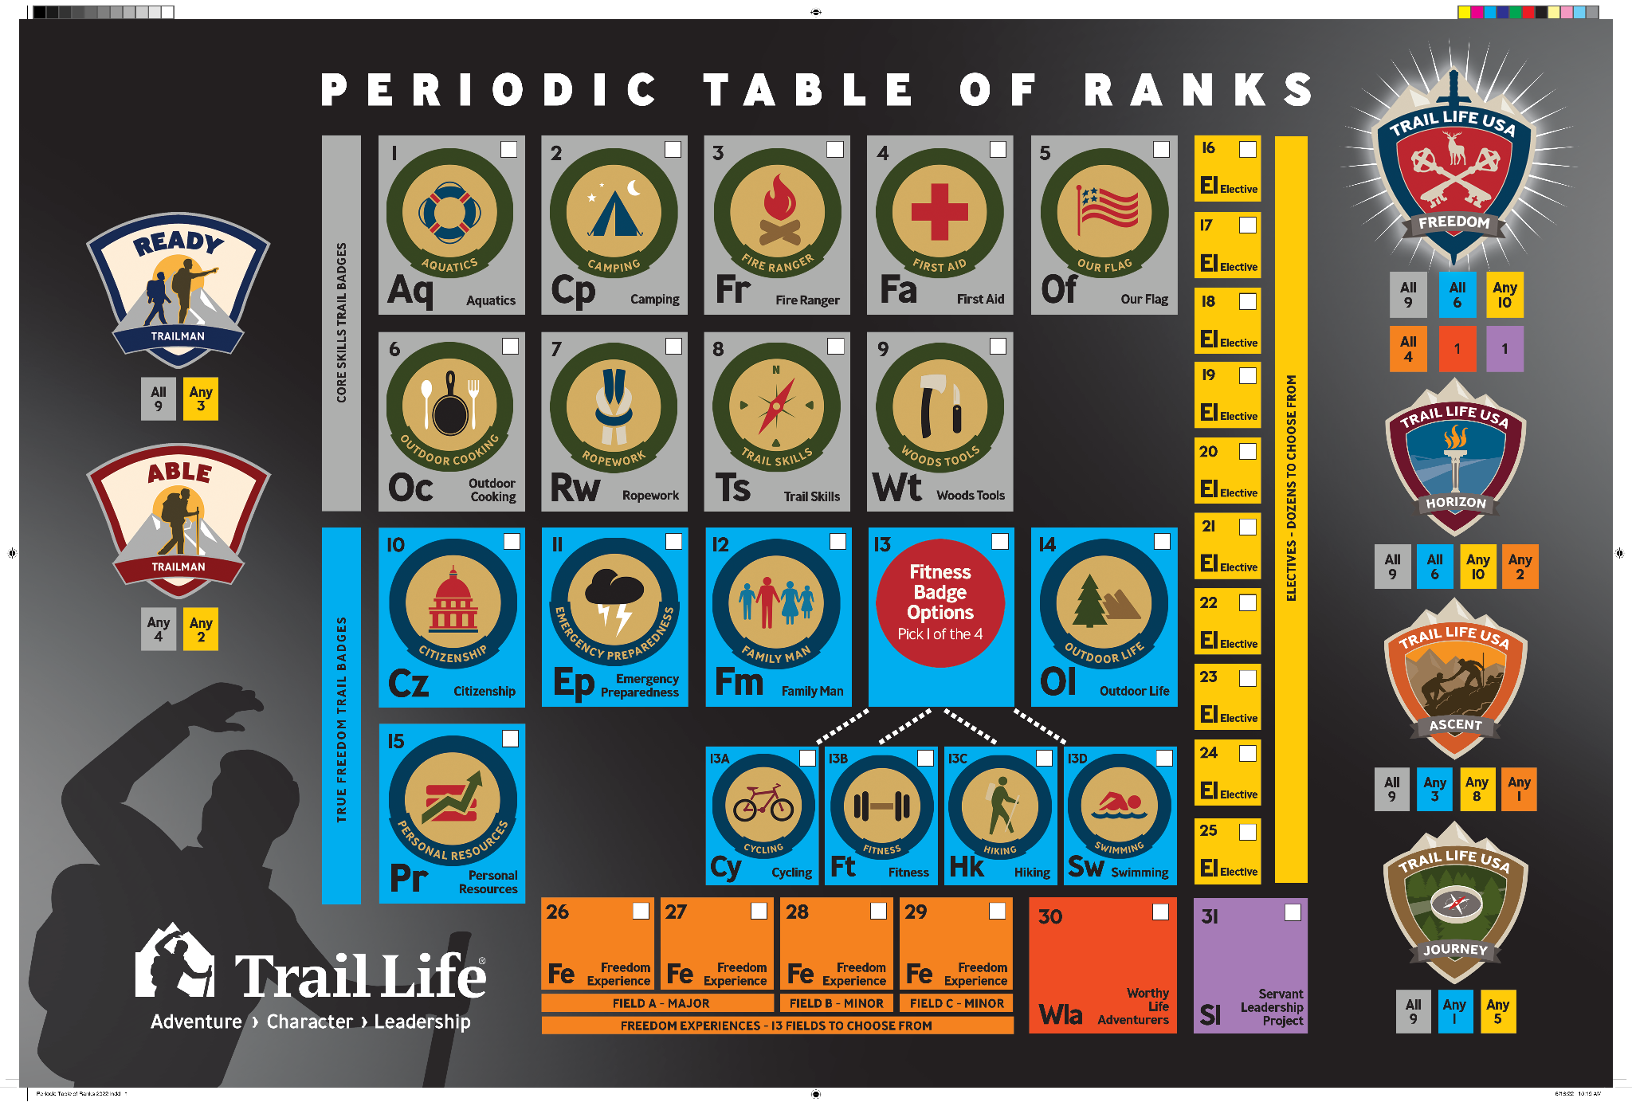
Tracking Resources cont.
Notes:
Say: “While Trail Life Connect is the official tracking resource for all of a Trailman’s advancements, Trail Life USA has created several great resources that can supplement tracking a Trailman’s advancement progress. (pause)
To assist the Trail Guides in recording all of the earned Trail Badges, [Click] the Patrol Tracking Charts are excellent tools. These charts can hang in the Navigator’s and Adventurer’s meeting spaces and are great visual aids to inspire the Trailmen to pursue the the next Rank. (pause)
[Click] The Periodic Table of Ranks is a perfect resource for Trailmen to use at home. This poster lays out the required elements that a Trailman will need to accomplish for each Rank. Each element is color coded so as to give the Trailman a quick visual cue of where he is along the advancement trail. (pause)
[Click] Lastly, each Trailman will use his Handbook to record physical signatures and sign-offs for all of the required Trail Badges, Ranks, and Awards.” [Click]
(Resource: The Trail Life Store)

Slide 17
Questions?
Session 107
Notes:
Say: “Do you have any questions about what I have just shared?”
([Click] when you’re ready to move on)

