Slide 1
Service
Session 211
Notes:
Say: Welcome to Session 211. This session will discuss the topic of service and how it is demonstrated in Trail Life USA. Service is a matter of the heart, something we do because we love others as Christ loves us, not because we gain something but because we care.
Mother Teresa said "It's Not How Much We Give But How Much Love We Put Into Giving."
(click)

Slide 2

“Serve” in Scripture
John 13: 14-15
Mark 10: 45
1 Peter 4: 10
Acts 20: 35
Matthew 5: 16
1 John 3: 18
Notes:
Say: “ Various forms of the word “serve” are mentioned over one thousand four hundred times in the Bible. This alone speaks to the important emphasis God puts on serving. A few examples in the scriptures of serving are as follows:
(click) In John 13:14-15 ESV, Jesus says, “ Teacher and Lord, then you must wash each other’s feet.”
(click) In Mark 10:45 ESV Jesus says, “For even the Son of Man came not to be served but to serve, and to give his life as a ransom for many.”
(click) In 1 Peter 4:10 ESV Peter says, “As each has received a gift, use it to serve one another, as good stewards of God’s varied grace.”
(click) In Acts 20:35 ESV Paul says, “In all things I have shown you that by working hard in this way we must help the weak and remember the words of the Lord Jesus, how he himself said, “It is more blessed to give than to receive.”
(click) In Matthew 5:16 ESV Jesus says, “In the same way, let your light shine before others, so that they may see your good works and give glory to your Father who is in heaven.”
(click) In 1 John 3:18 ESV John says, “Little children, let us not love in word or talk but in deed and in truth.”
As a Christ-centered organization, Trail Life strives to instill this biblical value of service in each Trailman and leader.”
(click)
ESV Bible

Slide 3

Servant Leadership
Notes:
Say: “Servant leadership replaces self-interest with the interest of others. As one of Trail Life’s core values, every Trail Life member from the CEO to the new Trailman should constantly strive to lead others in this manner. Some of the notable characteristics that are present in servant leaders are: humility, a willingness to work alongside others, leading by example, and the willingness to sacrifice.”
(click)
Nav/Adv LG Pg. 13 Core Value

Slide 4


Service Project Ideas
Notes:
Say: Service projects can look very different and should have varying levels of time and work commitments. Adult leaders should mentor each Trailman specifically as they serve others with various projects. Some project ideas are great one-time projects to meet a specific need, (click) such as picking up litter, building a handicap ramp, or planting a garden. Other project ideas are suited to be more long-term or recurring projects, (click) such as serving in a soup kitchen, visiting residents in a nursing home, or helping a disabled neighbor.
Service projects need to be approved ahead of time by adult Troop leaders. Service projects including political activities, Troop fundraisers, or for members of the Trailman’s family, while beneficial, cannot be approved for required service hours or advancement projects.”
(click)
Nav/Adv LG pg 231

Slide 5
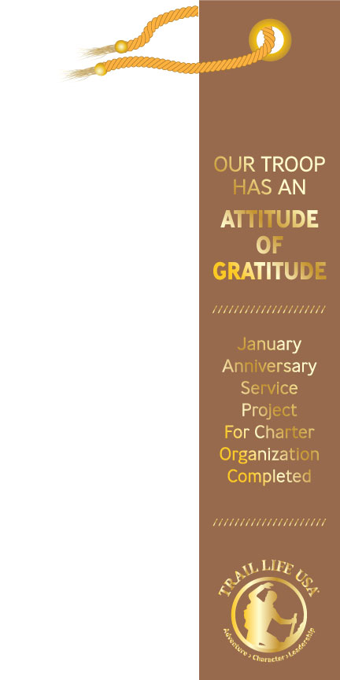

Service Project Annual Planning
Notes:
Say: Recurring service projects equip the Trailmen to develop a caring spirit and a consistent habit of service for a lifetime. In order to build this spirit in Trailmen, adult leaders should build service projects into the Troop and patrols’ annual plan.
Trail Life has two dedicated service opportunities for every Troop each year. In January each year, (click) Trail Life promotes the Attitude of Gratitude ribbon campaign. This service campaign is designed for each Troop to give back to its Charter Organization. In June of each year, (click) Trail Life promotes the Serve in Love campaign. This campaign is specifically focused on the Troop serving its local community.
As projects are planned out, ensure that all service projects are age appropriate and all safety protocols are observed. Also ensure that all necessary paperwork, including permission slips, are filed with the appropriate organizations..
(click)
Nav/Adv LG pg 231-232

Slide 6




Service for Advancement
Notes:
Say: Service is not only encouraged in the Troop but built into every level of the Trail Life program.
(click) In the Woodlands Trail, each patrol has a Core Step in the Values Branch for service. Trail Guides teach the Trailmen how service is defined and why it is good to serve others.
(click) In the Navigators program, at least 15 hours of service each year as a Navigator is required in order to reach the Able Rank as well as the Ready Rank. For each of these 15 hours of service completed, the Trailman will receive a silver Service Star to be affixed to his Standard.
(click) In the Adventurers program, at least 20 hours of service each year as an Adventurer is required in order to earn the Horizon Award. For each of these 20 hours of service completed, the Trailman will receive a gold Service Star to be affixed to his Standard. Also if a Trailman pursues the Freedom Award, he is required to fully plan, fund, and lead a team of volunteers in completing a major Servant Leadership Project.
(click) In addition to the Ranks and Awards, Trail Life’s Worthy Life Award for each patrol level has a service project option.
(click)
Woodland guide pg 89
Nav/Adv HB pgs 70 - 105
Nav/Adv Leader Guide pgs.217-244
Trail Life Connect

Slide 7
Questions?
Session 211
Notes:
Say: “Are there any questions about what I have shared?”
(click when you’re ready to move on)

